Slide 1



ELECTVIZ
ELECTION DATA VISUALIZATION FOR MEDIA
Mentor: Mrs. Nityashree S J
Submitted by: Jasleen Kaur (Team C)

Slide 2
INTRODUCTION
ElectViz is an interactive election data visualization project developed as part of our internship. The project focuses on analyzingand presenting large-scale Indian election data using Power BI to uncover meaningful patterns and trends.
The primary objective of ElectViz is to transform complex election datasets into clear, intuitive, and visually engaging dashboards.
By combining data analytics with effective visualization techniques, the project demonstrates how data-driven insights can enhance political reporting and support informed interpretation of election out

Slide 3
SYSTEM DESIGN AND WORKFLOW
1.Data Collection: Historical Indian general election dataset containing state, year, constituency, candidate, party, votes, and elector details collected from Kaggle [https://www.kaggle.com/datasets/awadhi123/indian-election-dataset]
●
2.Data Preprocessing: Data cleaning and transformation performed in Power BI Power Query where we Handled missing values, standardized party names, and formatted data types.
●
3.Creation of custom columns: Added Region (North, South, East, West) and Voter Turnout Percentage (Votes Polled / Electors × 100)
●
4.Data Modeling: Establishing relationships between fields such as State, Year, Party, and Constituency.
●
5.Data Visualization: Designing interactive dashboards using charts, tables, maps, slicers, and KPIs while implementing filters and drill-through features for detailed analysis.
●
6.Insight Generation: Identification of voting trends, party dominance, gender participation, and regional performance.

Slide 4
FUTURE ENHANCEMENT
•Extend the project to include real-time and post-election data integration, enabling timely analysis and live election monitoring.
•Enhance dashboards with demographic and socio-economic indicators such as population, literacy rate, and urban–rural distribution to provide deeper electoral context.
•Improve interactivity by enabling deeper drill-down capabilities from national-level summaries to state, constituency, and candidate-level insights.
•Implement AI-powered insight generation to automatically highlight key patterns, anomalies, and significant changes in election outcomes.
•Expand accessibility through mobile-responsive dashboards and role-based views for analysts, media professionals, and the general public.
•Strengthen data validation and governance mechanisms to ensure accuracy, consistency, and scalability as datasets grow.

Slide 5
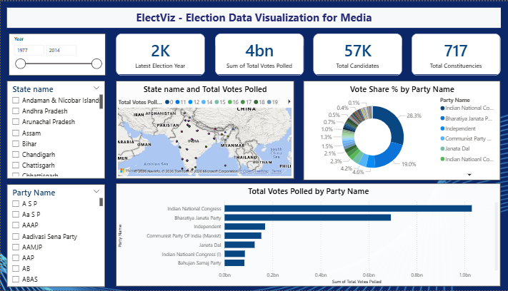
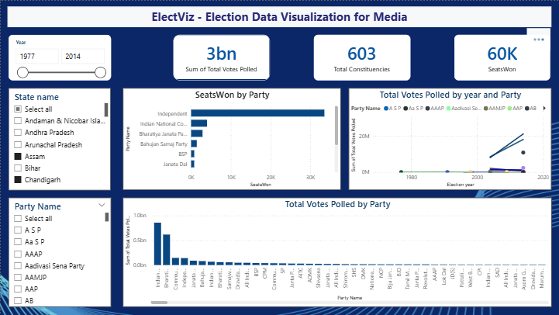
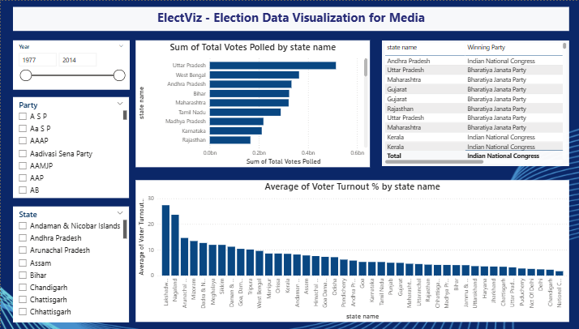
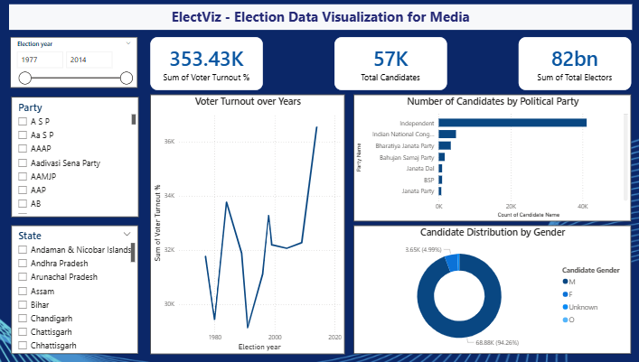
SNAPSHOTS

Slide 6
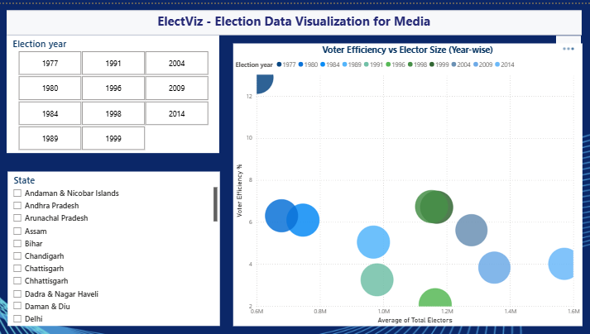
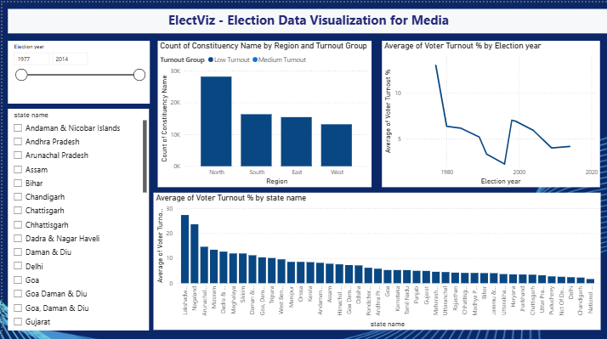
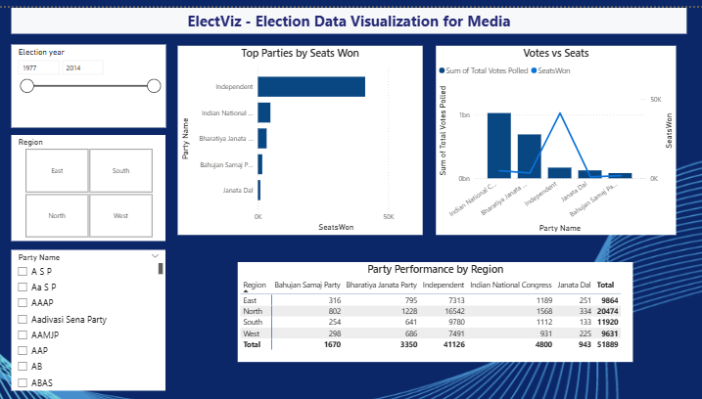
SNAPSHOTS

Slide 7
CONCLUSION
The ElectViz: Election Data Visualization for Media project successfully demonstrates how data analytics and visualization canconvert complex election datasets into meaningful and actionable insights. By leveraging Power BI, the project transforms large-scale Indian election data into interactive dashboards.
Overall, ElectViz enhances political reporting by enabling fact-based storytelling and informed interpretation of election outcomes. It lays a strong foundation for future extensions such as real-time election tracking and predictive analysis

Slide 8
THANK YOU

